Slide 1
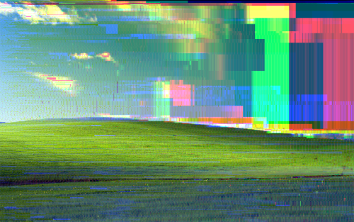


Introduction to Computational Thinking and Data Science
Prof. Yolanda Gil
University of Southern California
gil@isi.edu
http://www.datascience4all.org
CC-BY
Attribution
ACI-1355475
Last Updated:
September 2016
https://www.flickr.com/photos/hellocatfood/10545396704

Slide 2
Intended Audience
Designed for students with no programming background who want to have literacy in data and computing to better approach data science projects
Computational thinking: a new way to approach problems through computing
Abstraction, decomposition, modularity,…
Data science: a cross-disciplinary approach to solving data-rich problems
Machine learning, large-scale computing, semantic metadata, workflows,…

Slide 3

These materials are released under a CC-BY License
https://creativecommons.org/licenses/by/2.0/
You are free to:
Share — copy and redistribute the material in any medium or format
Adapt — remix, transform, and build upon the material
for any purpose, even commercially.
The licensor cannot revoke these freedoms as long as you follow the license terms.
Under the following terms:
Attribution — You must give appropriate credit, provide a link to the license,
and indicate if changes were made. You may do so in any reasonable manner,
but not in any way that suggests the licensor endorses you or your use.
Artwork taken from other sources is acknowledged where it appears.
Artwork that is not acknowledged is by the author.
Please credit as: Gil, Yolanda (Ed.) Introduction to Computational Thinking and Data Science. Available from http://www.datascience4all.org
If you use an individual slide, please place the following at the bottom: “Credit: http://www.datascience4all.org/”
As editors of these materials, we welcome your feedback and contributions.

Slide 4
Acknowledgments
ACI-1355475
These course training materials were originally developed and edited by Yolanda Gil (USC) with support from the National Science Foundation with award ACI-1355475
They are made available as part of http://www.datascience4all.org
The course materials benefitted from feedback from many students at USC and student interns, particularly Taylor Alarcon (Brown University), Alyssa Deng (Carnegie Mellon University), and Kate Musen (Swarthmore College)
We welcome new contributions and suggestions

Slide 5
Goals of the Course
Course is designed for students with no programming background and want to have literacy in data and computing to better approach data science projects
Conceptual Learning
Practical Learning
Computational thinking: a new way to approach problems through computing
Simulation, data analysis, data mining
Data science: a cross-disciplinary approach to solving data-rich problems
Machine learning, large-scale computing, semantic metadata
Workflows: a graphical programming environment that enables non-programmers to experiment with complex multi-step data analysis environments
Application domains: exposure to past and ongoing projects where data science exposes multi-disciplinary challenges
Social networks, hydrology, proteomics, genomics, medicine, etc.

Slide 6
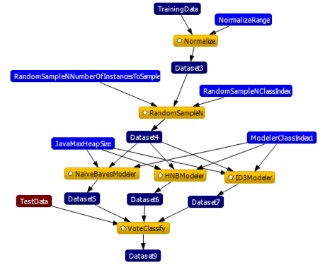
Workflows Make Data Science Accessible to Non-Programmers

Slide 7
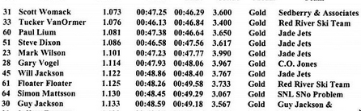
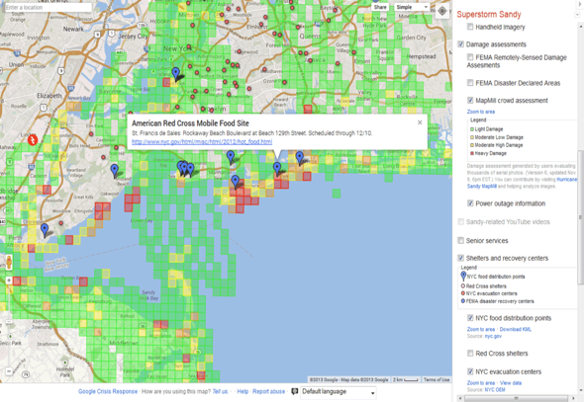
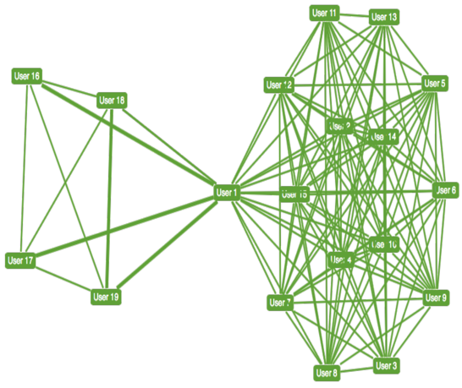
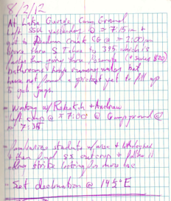
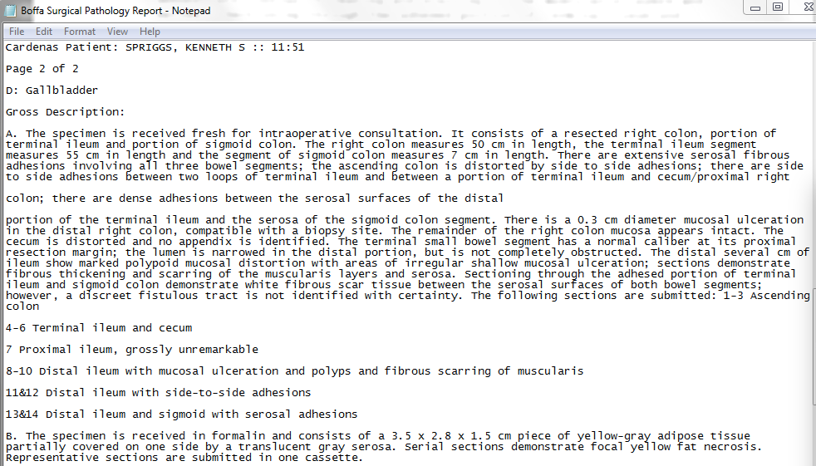
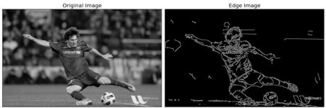
Experiment with Diverse Data

Slide 8
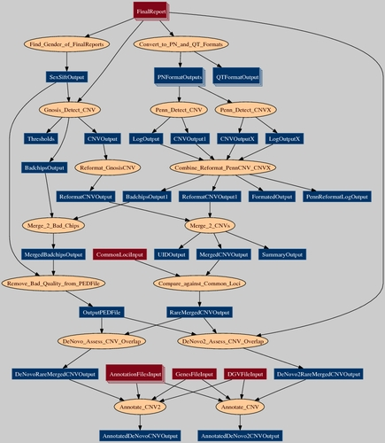
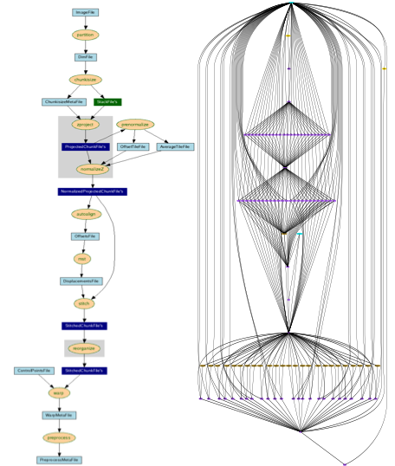
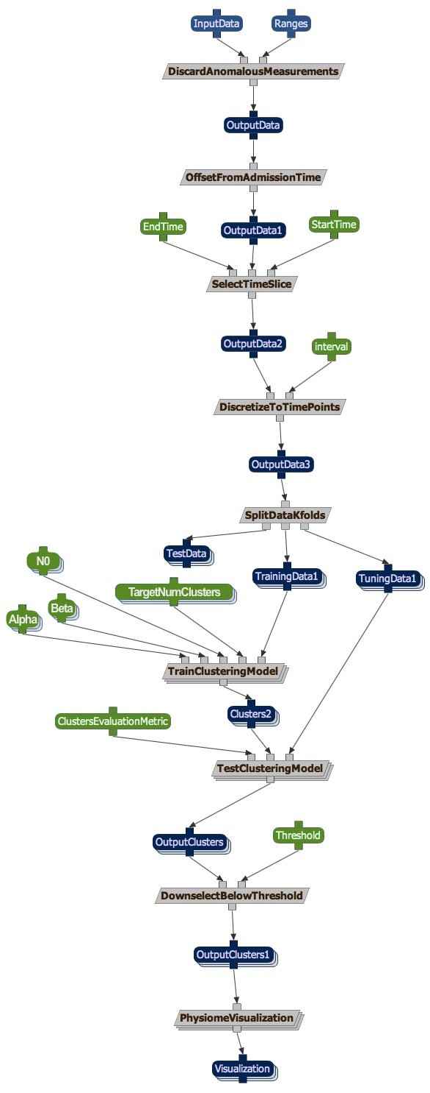
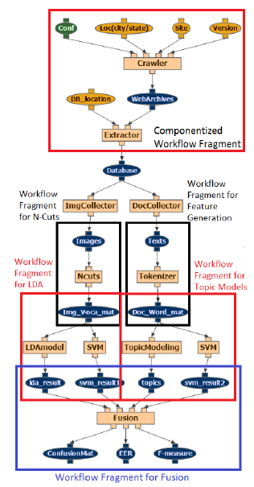
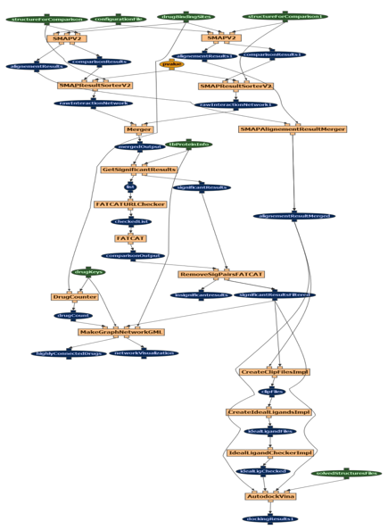
Experiment with Data Science in a Variety of Domains
genomics
image processing
clinical
research
proteomics
text
analytics

Slide 9
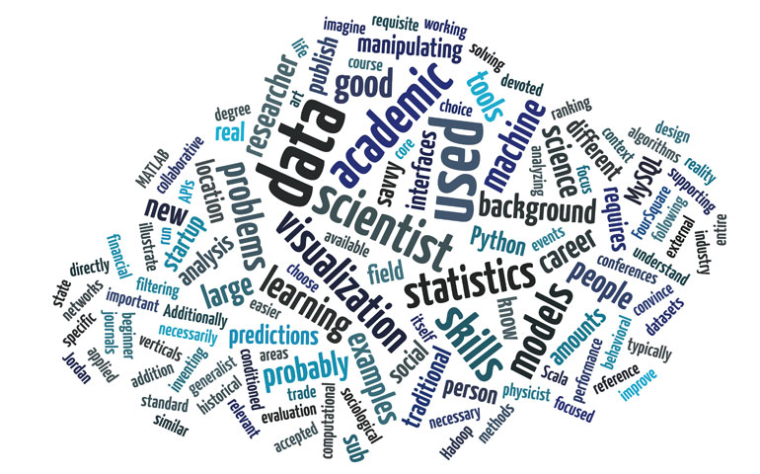
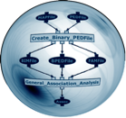

Section I: Introduction
Computational thinking and data science
Data
What is data
Major types of data
Basic terminology
Data analysis software
Multi-step data analysis as workflows
http://blog.ginger.io/data-science-101/

Slide 10
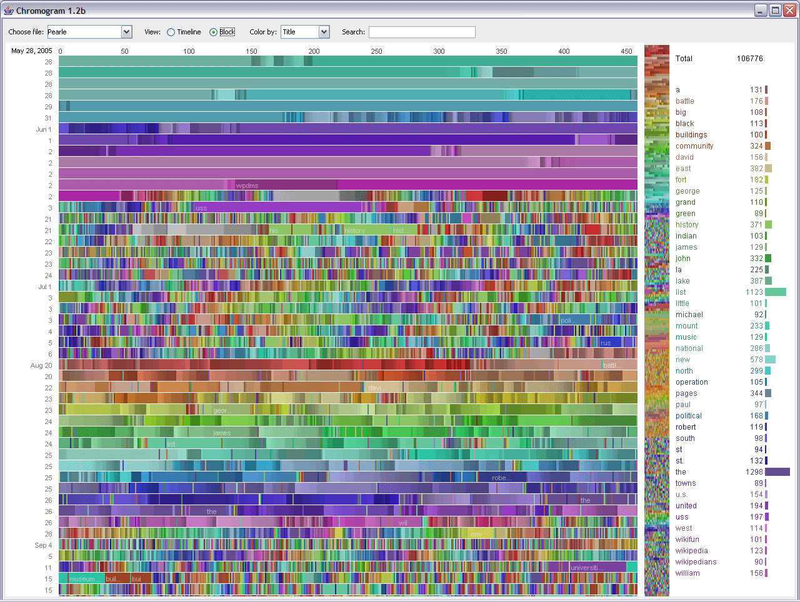
II: Data Analysis
Data analysis tasks
Classification, clustering, pattern detection
Data pre-processing
Data visualization
Data lifecycle
https://es.wikipedia.org/wiki/Big_data

Slide 11
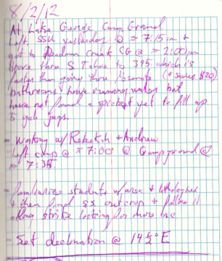
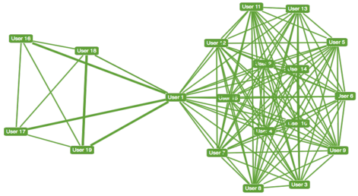

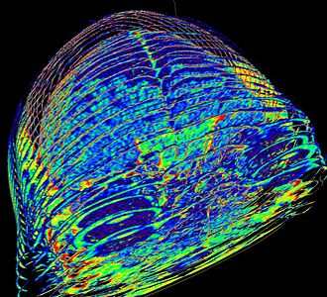
III: Data Analysis in Practice
Analyzing different kinds of data
Time series, text, multimedia, networks, spatial, …
Parallel and distributed computing
Multi-core, clusters, grids, web services, …
Speedup, dependencies, critical paths, Amdahl’s law, MapReduce

Slide 12
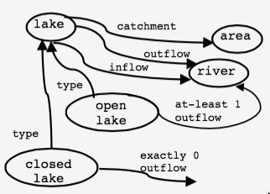
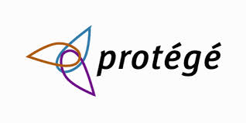
IV: Metadata
Semantic metadata
Ontologies
Provenance

Slide 13
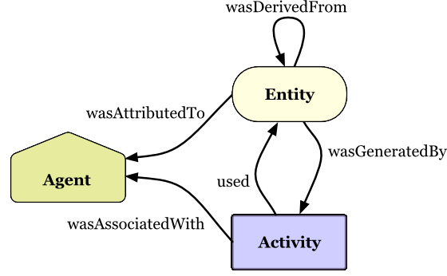
V: Data Dissemination
Data formats and standards
Provenance
Data stewardship
Data identifiers, data citation

Slide 14
VI: Advanced Topics
Privacy and sensitive data
Crowdsourcing data collection
Multi-disciplinary collaboration
Project management

Slide 15
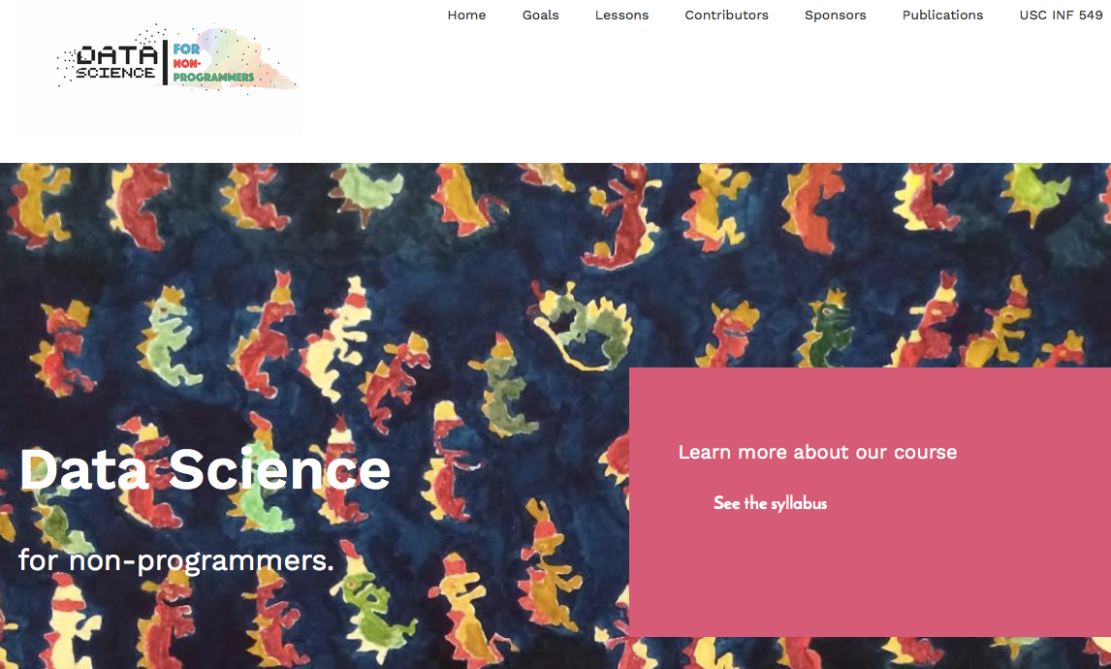
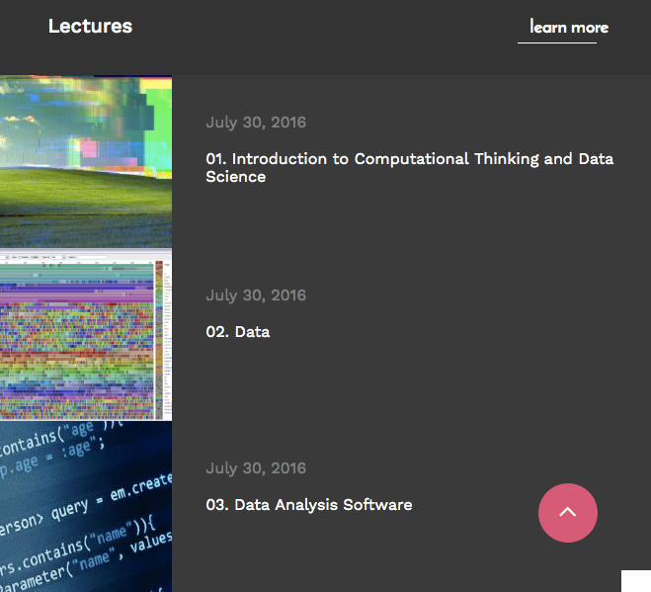
http://datascience4all.org/

